Slide 1
Planning an Enterprise OpenStack Deployment
Rick Ashford
Sr. Sales Engineer
rashford@suse.com
Jeff Applewhite
Technical Marketing Engineer
jeff.applewhite@netapp.com

Slide 2
Agenda
Introduction
What initial considerations need to be made?
What specific details need to be planned, and how do they impact the overall implementation?
SUSE® OpenStack Cloud 5 on NetApp Clustered Data ONTAP

Slide 3

Why bother?

Slide 4

Why bother?

Slide 5
Initial Considerations

Slide 6
Initial Considerations
What problem are you trying to solve by implementing a private Infrastructure-as-a-service (IaaS) cloud?

Slide 7
Initial Considerations
Who are the expected end-users of your cloud, and what do they want to get out of it?

Slide 8
Initial Considerations
How much of your current infrastructure and workflows do you want to keep?

Slide 9
Initial Considerations
What are the business and technical requirements for the project?

Slide 10
Initial Considerations
What are the constraints for this project?

Slide 11
Initial Considerations
What additional resources do you need to have a successful deployment?

Slide 12
Technical Details

Slide 13
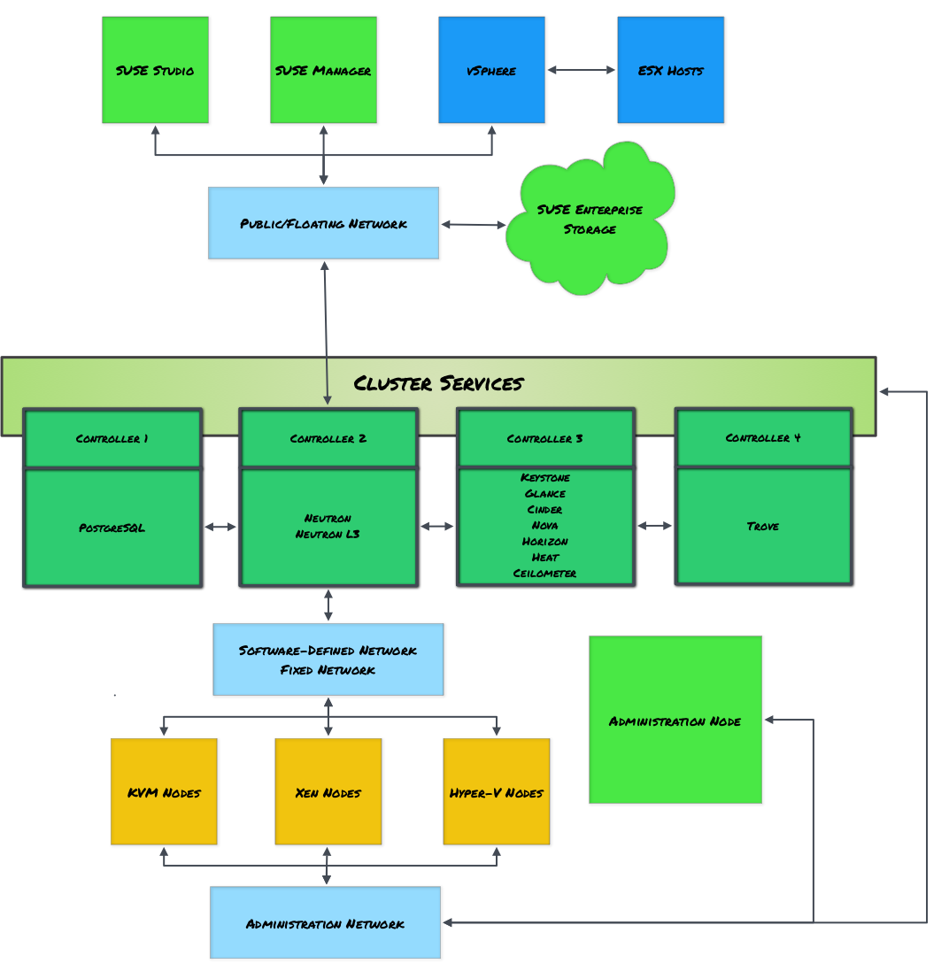

Slide 14
Control Plane
How do you want to group the control plane services
  Typical separated services
    Backend database
    Neutron L3 agent
    Trove
Is a highly-available infrastructure important?
  What do you want to use for shared storage for RabbitMQ and PostgreSQL?
  What STONITH mechanism is appropriate?

Slide 15
Infrastructure
Which hypervisor(s) do you want to support?
  KVM, Xen, VMware, Hyper-V
How do you want to handle storage?
  What storage backends are available?
    SAN, local disk, Ceph, NAS, etc.
  Which services?
    Storing virtual machines
    Image repository
    Volume storage
    Object storage

Slide 16
Network
Which Neutron plugin do you want to use?
  Linuxbridge
  VLAN
  Open vSwitch
  VMware
  Cisco
What encapsulation protocol do you want to use?
  VLAN
  GRE

Slide 17
Network
Admin 192.168.124.0/24
Fixed 192.168.123.0/24
SDN 192.168.130.0/24
Public 192.168.126.0/24
Floating 192.168.126.0/24
Storage 192.168.125.0/24 (Swift)

Slide 19
Additional Considerations

Slide 20
Additional Considerations
Identify a patching strategy
  Updater barclamp
  SUSE Manager
  Manual
  “Cross your fingers and hope I can get away without it”

Slide 21
Additional Considerations
When going from POC to production, which parts of your infrastructure will need to be modified?
  Networking
  Physical infrastructure
  Single-cluster control plane → Multi-cluster control plane
  Integration with Active Directory (or other LDAP store)
  SUSE Studio integration

Slide 22
Additional Additional Consideration

Slide 23


Slide 24
SUSE OpenStack Cloud Deployment Guide
www.suse.com/documentation/suse-cloud-5

Slide 26
SUSE® OpenStack Cloud 5 on NetApp Clustered Data ONTAP
May 21, 2015

Slide 27
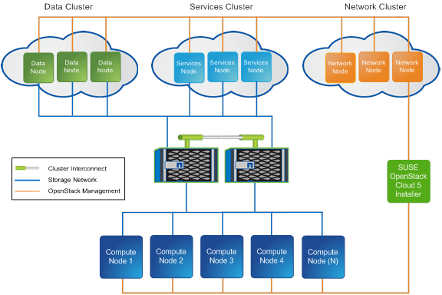
Solution Overview

Slide 28
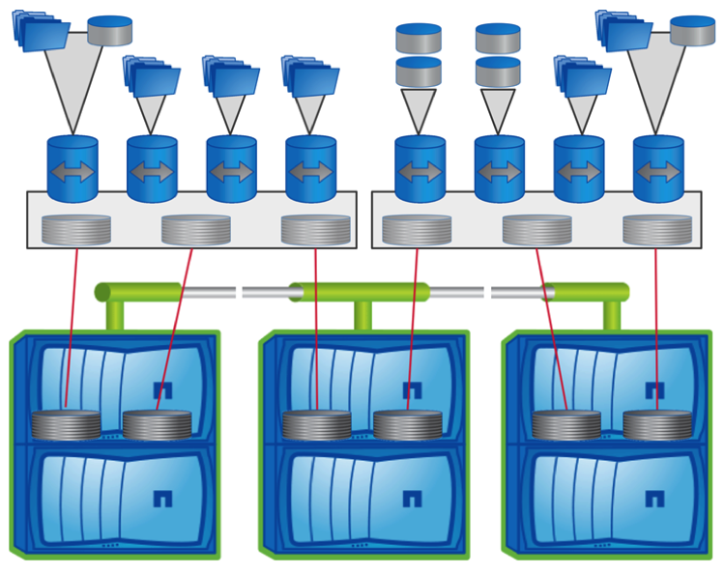
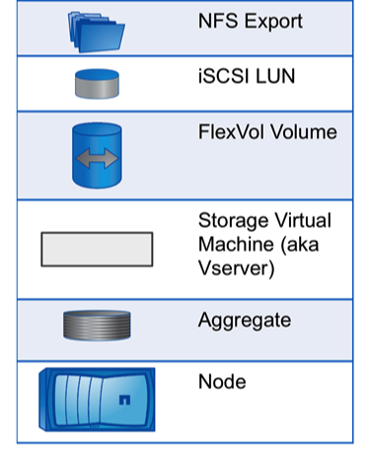
FAS Objects

Slide 29
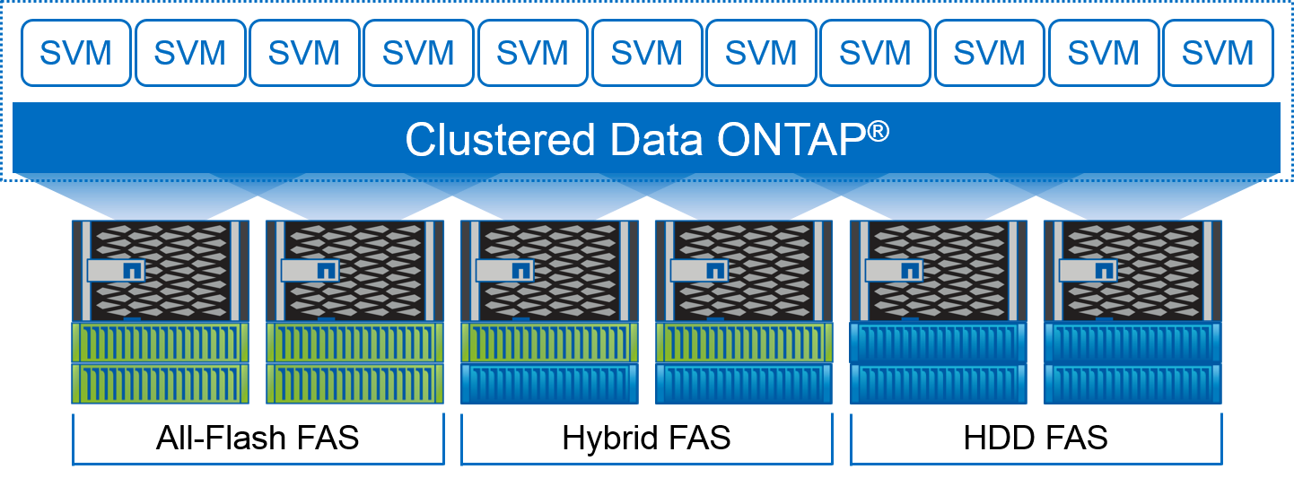
Dedicated or Mixed Disk Types

Slide 30

Deployment Preparatory Steps
Set up switch ports using link aggregation for all nodes
Create or modify a Storage Virtual Machine on NetApp
Setup iSCSI disks for shared block device fencing
Setup PostgreSQL, RabbitMQ, Cinder, Glance FlexVols on NetApp
Optionally setup Nova FlexVol for live migration)

Slide 31
Deployment Procedures
Build and configure SUSE OpenStack Cloud 5 host
Modify the network configuration with Yast2
Run install-suse-cloud
Perform discovery on all target hosts in the cluster
Install all nodes with batch edit
Setup the block devices on all 9 cluster hosts
Deploy HA Controllers
Deploy the OpenStack services

Slide 32
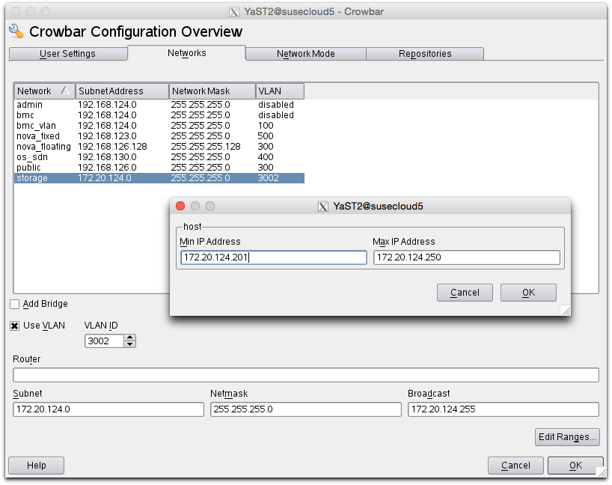
Modify the Storage Networking
Run # yast2 crowbar
Then run # screen install-suse-cloud

Slide 33
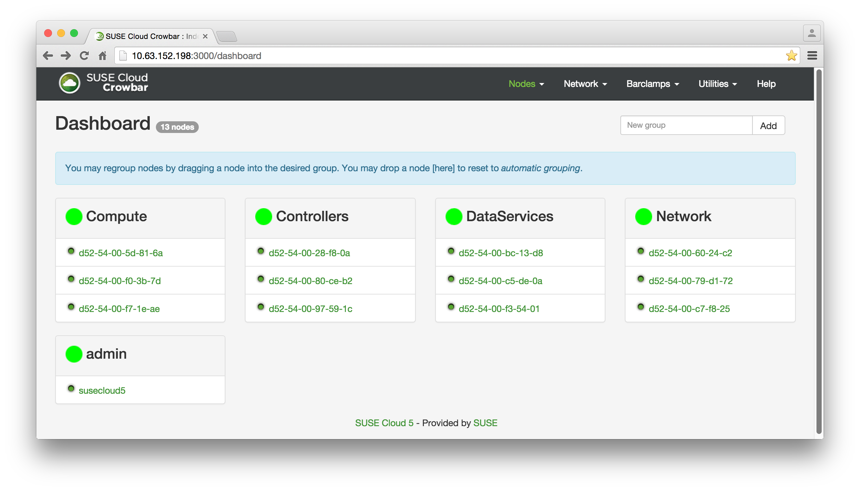
Discover all nodes and group

Slide 34
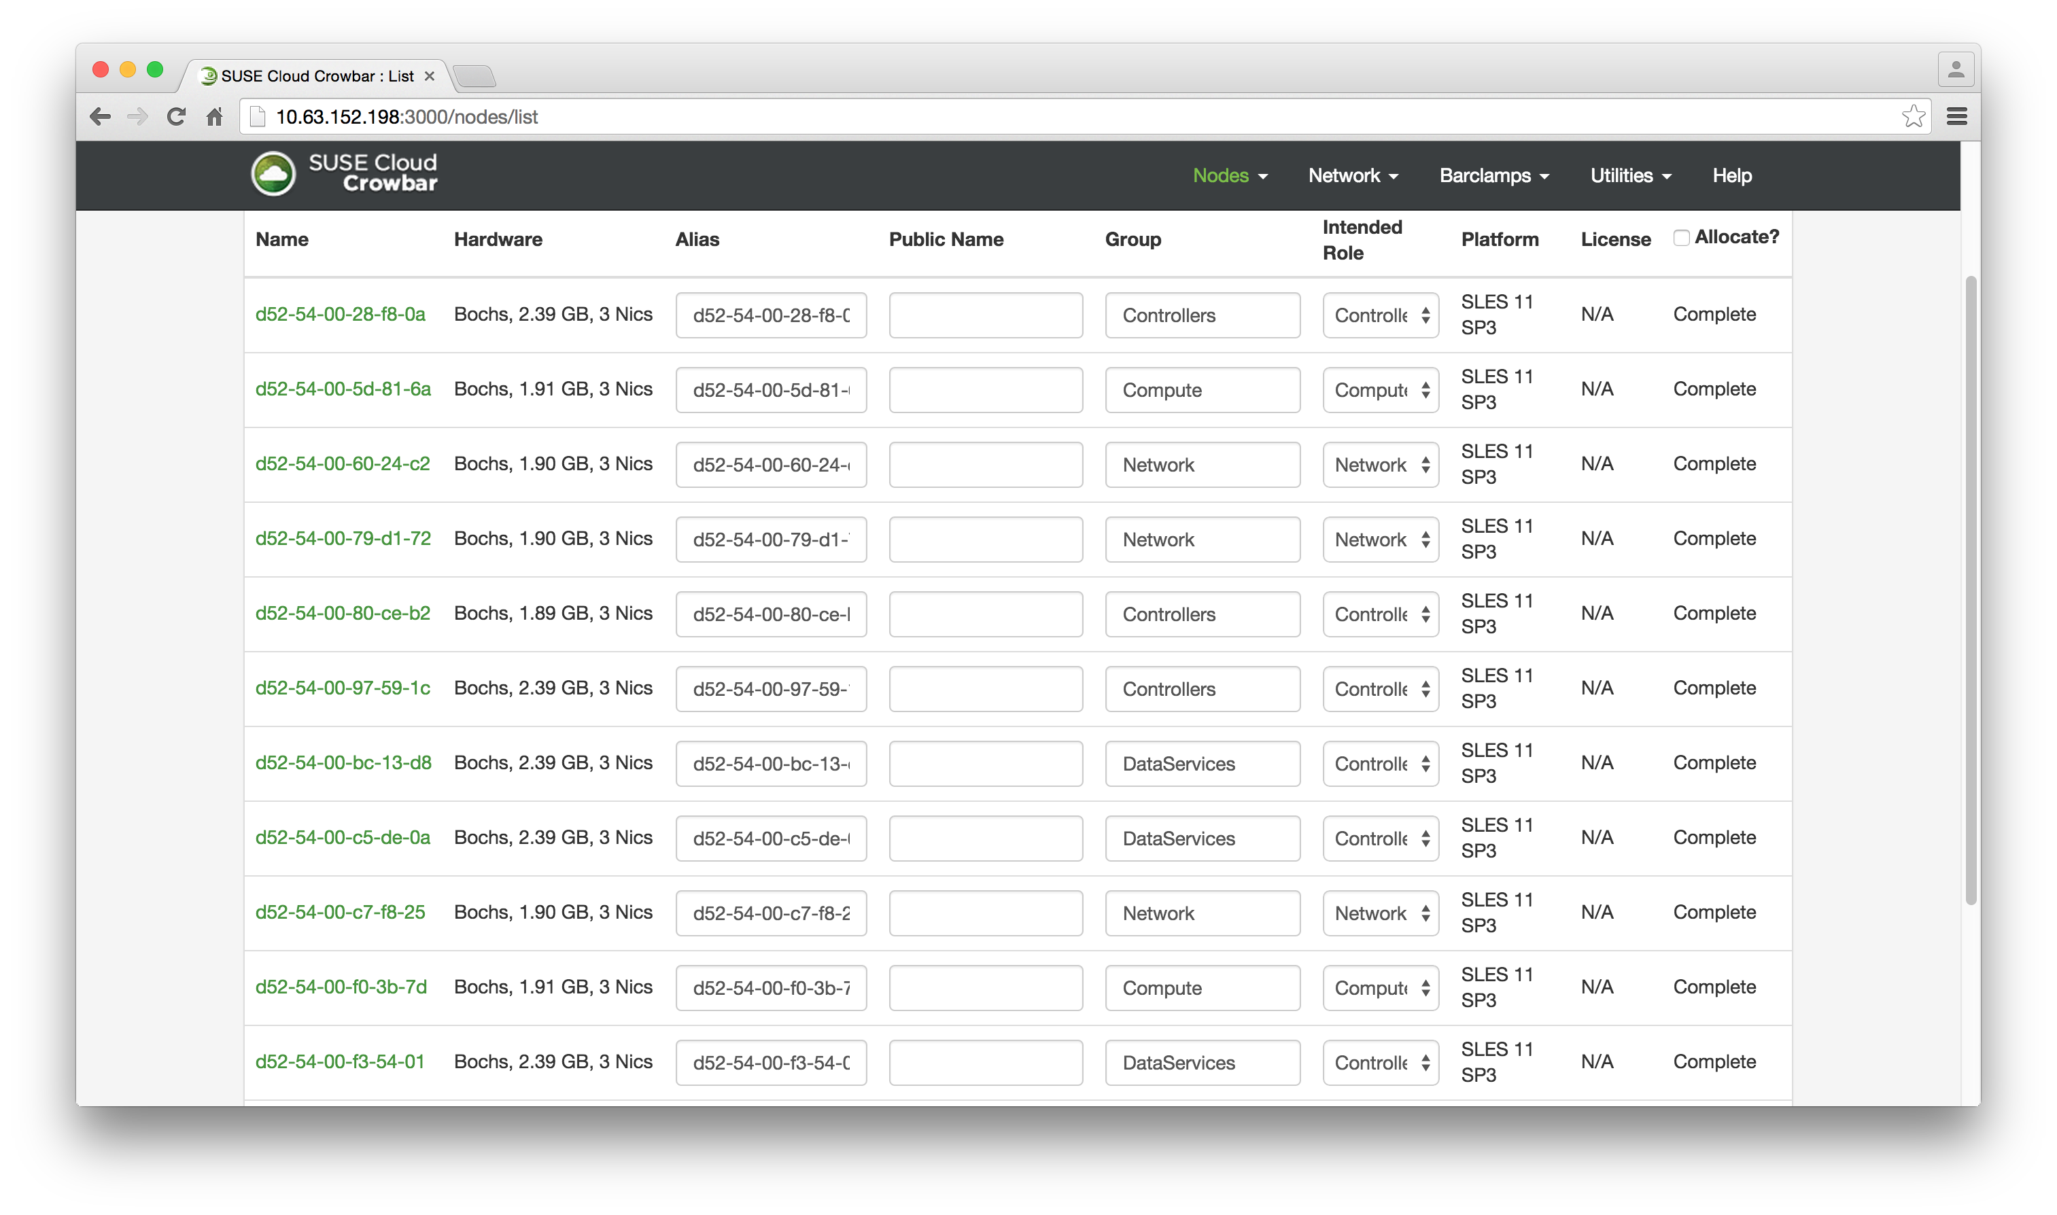
Install Nodes with Batch edit

Slide 35
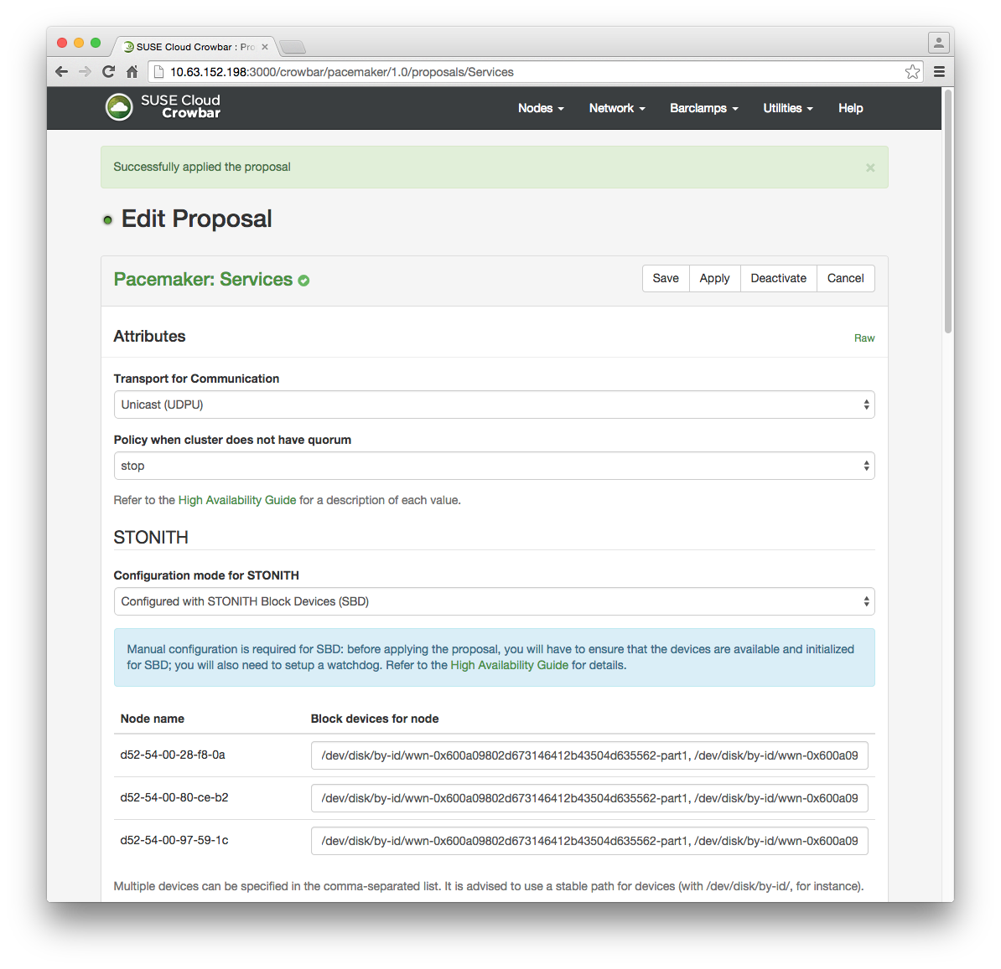
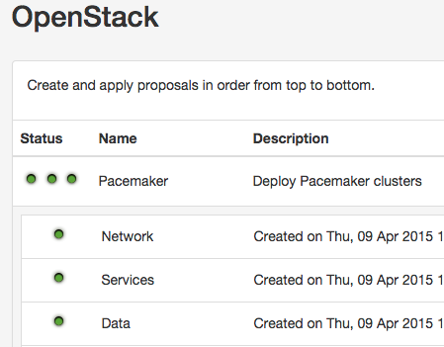
Create Pacemaker Clusters (3x3 nodes)
When complete:

Slide 36
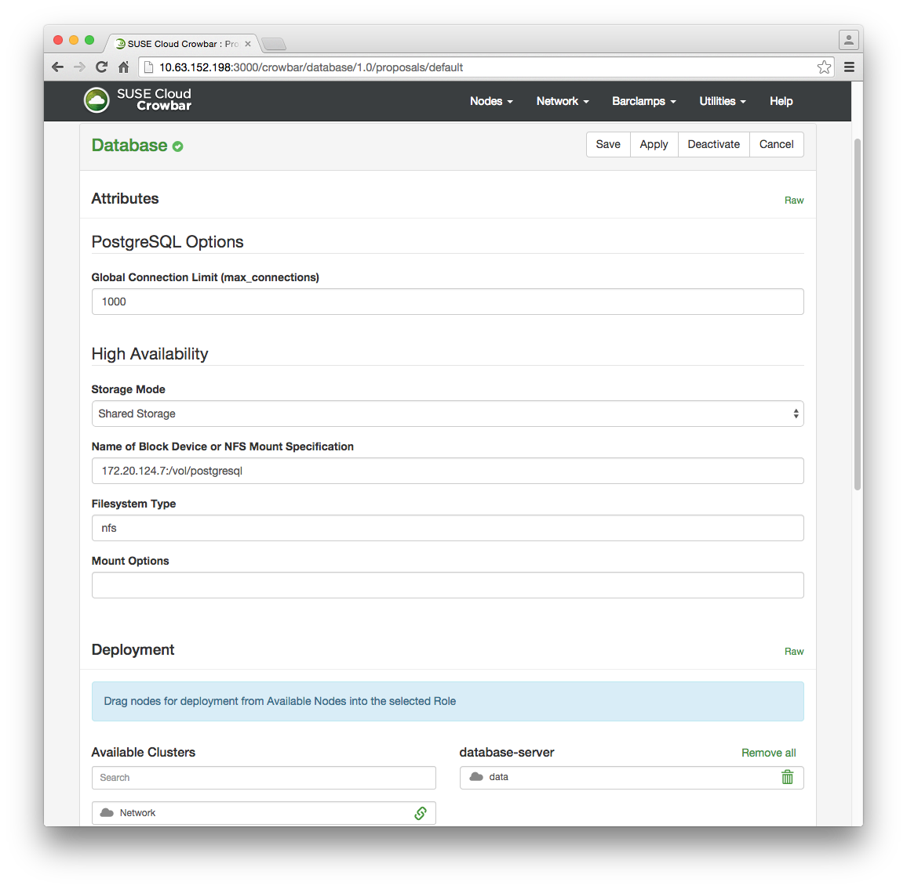
Install PostgreSQL and RabbitMQ to Data Cluster
Data Cluster

Slide 37
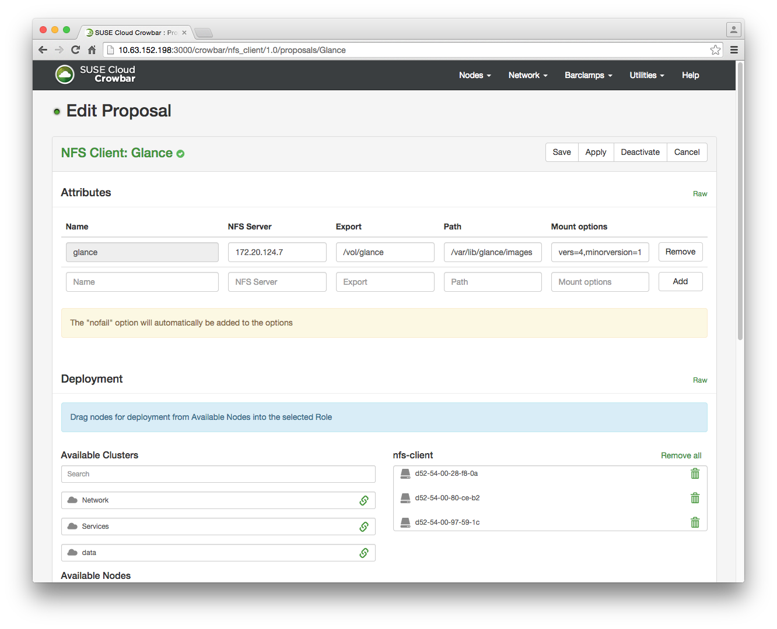
Setup Glance (and Nova) NFS Mounts
Service Cluster Nodes

Slide 38
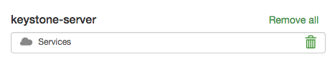
Install OpenStack Services to Service cluster
The Service cluster object becomes the deployment target for all OpenStack core services except Neutron.
Services Cluster
Note: Default settings of the Barclamps are generally fine (even Glance will now deploy using “files” that are on the NFS mount.

Slide 39
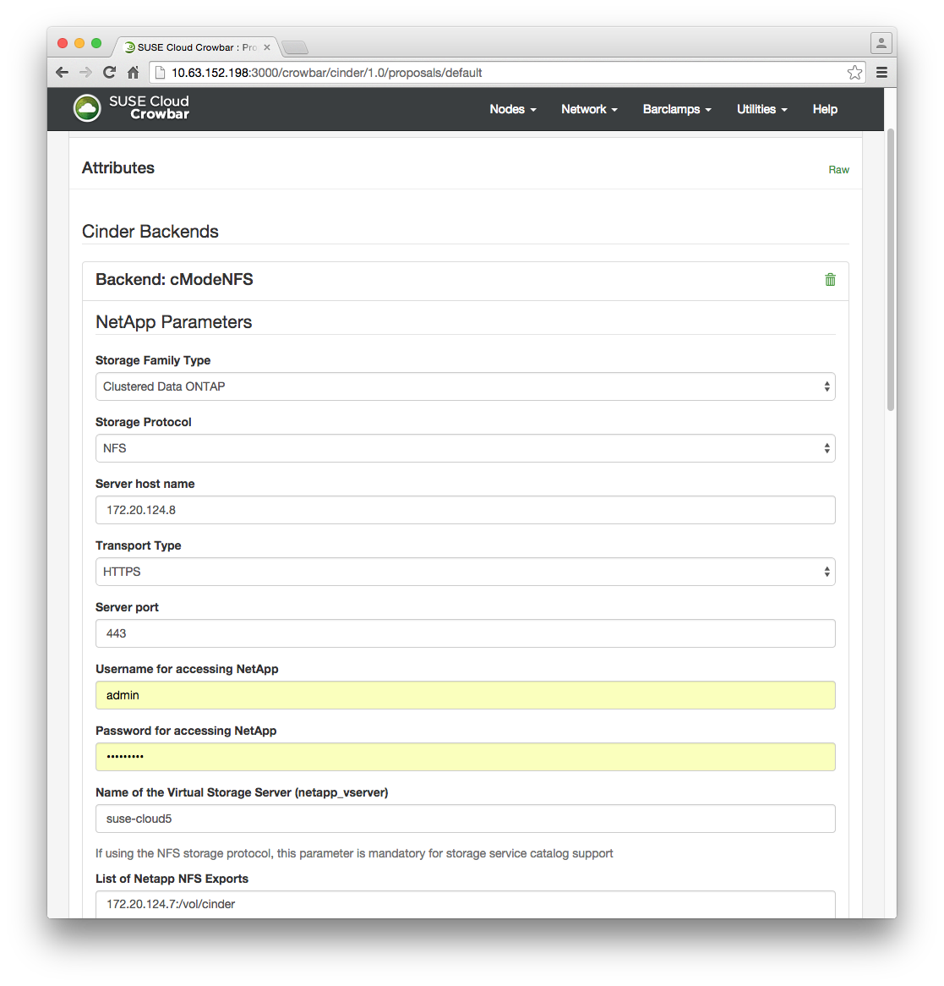

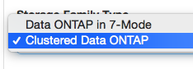

Cinder
Choose mode
Choose protocol
NFS Export(s)

Slide 40
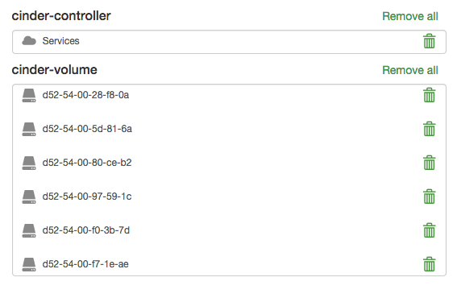
Cinder Deployment Targets
Services Cluster
All nodes
(except Network)

Slide 41

Summary
The combination of SUSE OpenStack Cloud 5 and NetApp Clustered Data ONTAP storage provides the following benefits:
High availability at the OpenStack service and storage tiers
Unified storage for multi-protocol services (iSCSI, NFS, FC)
NetApp has the unique capability for providing a storage service catalog where the OpenStack administrator defines levels of service that are needed.

